Slide 1
Magnetic Field measurements at milliarcsecond resolution around massive young stellar objects
Gabriele Surcis
Collaborators:
W.H.T. Vlemmings (Chalmers Uni, Sweden), H.J. van Langevelde (JIVE, Leiden Uni, The Netherlands),
B. Hutawarakorn Kramer (MPIfR, Germany), A. Bartkiewicz (Copernicus Uni, Poland), M.G. Blasi (Uni Basilicata, Italy), L.H. Quiroga-Nuñez (Leiden Uni, The Netherlands)
12th EVN Symposium – Cagliari 7-10 October 2014 Gabriele Surcis - 9th October 2014

Slide 2
Outline
Introduction
magnetic field vs outflow in low-mass star formation
magnetic field in massive star formation
6.7-GHz methanol masers
Observations
Results
magnetic field total sample: first statistical results
Zeeman-splitting coefficient
Conclusions & Follow-ups
12th EVN Symposium – Cagliari 7-10 October 2014 Gabriele Surcis - 9th October 2014

Slide 3
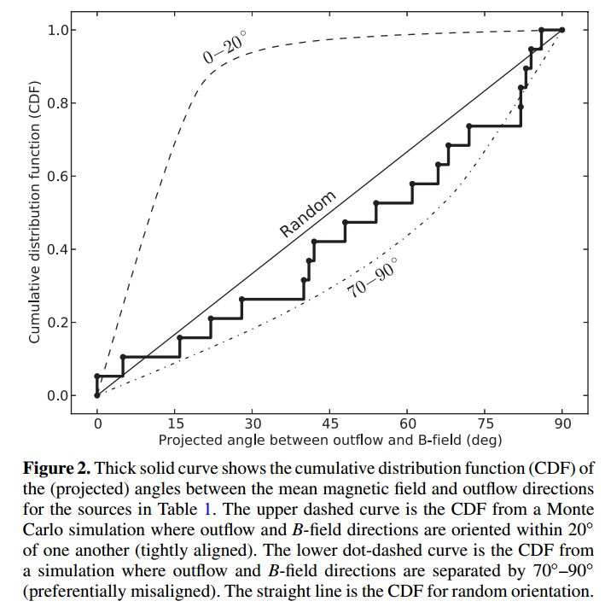
Introduction: B vs outflow in low-mass star formation
Hull et al. 2013
based on 17 sources (CARMA obs; 2’’.5)
K-S -> 0º-20º = 0.0000003 %
-> 70º-90º = 79 %
-> random = 64 %
no alignment between outflows and B
Chapman et al. 2013
based on 7 sources (SHARC-II obs; 10’’)
Hull, C.L.H. et al. 2013, ApJ, 768, 159
alignment between outflows and B at a confidence level of ̴97%
12th EVN Symposium – Cagliari 7-10 October 2014 Gabriele Surcis - 9th October 2014

Slide 4
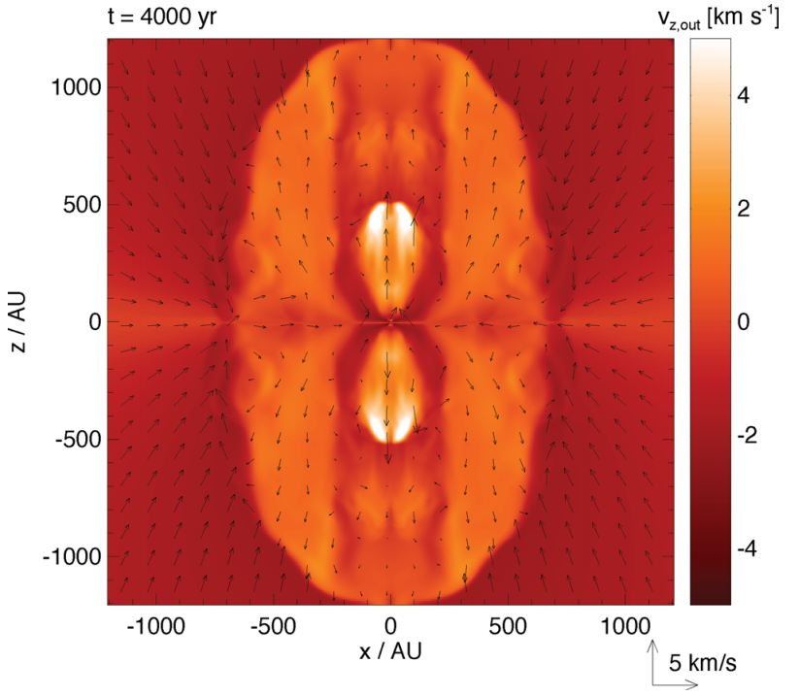
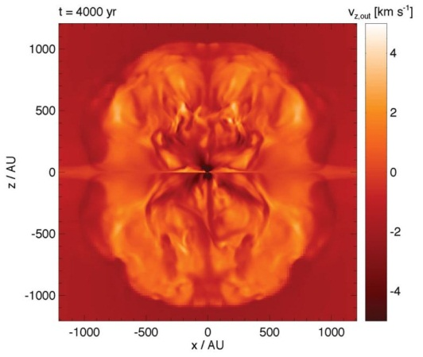
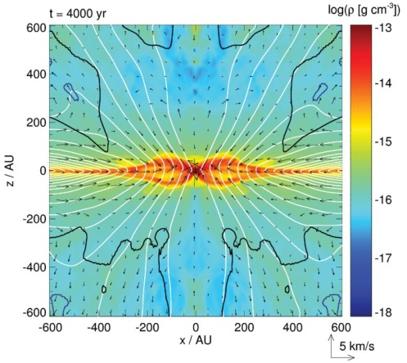
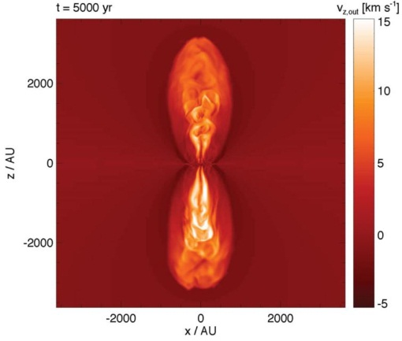
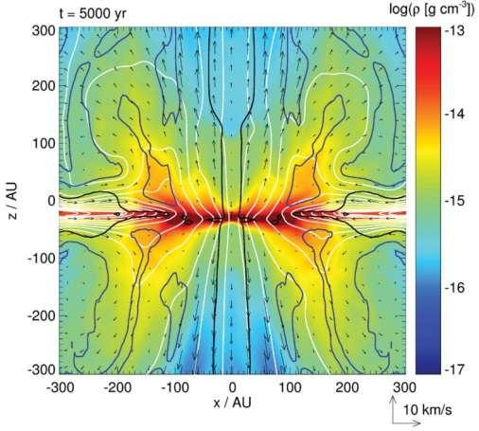
Introduction: B in massive star formation
MHD simulations
Seifried et al. 2012, MNRAS, 422, 347
strong initial
magnetic field intensities
(µ=5)
low initial
magnetic field intensities
(µ=20-120)
slow & poorly collimated
outflows
fast & collimated
outflows
See next Talk
by J.-S. Kim
After the formation of a Keplerian disk (µ=10.4)
12th EVN Symposium – Cagliari 7-10 October 2014 Gabriele Surcis - 9th October 2014

Slide 5
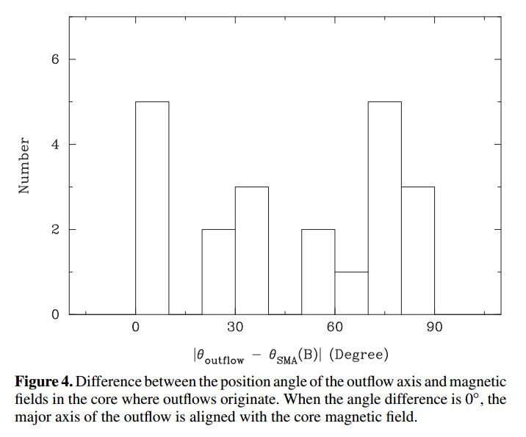
Introduction: B in massive star formation
Zhang et al. 2014
based on 21 sources (SMA obs; ̴2’’)
no correlation between outflows and B
Zhang, Q. et al. 2014, ApJ, 792, 116
12th EVN Symposium – Cagliari 7-10 October 2014 Gabriele Surcis - 9th October 2014

Slide 6
Introduction: 6.7-GHz methanol masers
Masers are bright and have narrow spectral lines
Frequency
(GHz)
Density
(cm⁻³)
OH
CH₃OH
22
10⁸ < n_{H2} < 10¹⁰
H₂O
6.7
10⁷ < n_{H2} < 10⁹
protostar
1.6/1.7
n_{H2} < 10⁸
12th EVN Symposium – Cagliari 7-10 October 2014 Gabriele Surcis - 9th October 2014

Slide 7
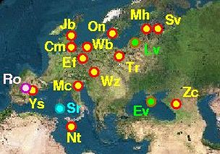
Observations
European VLBI Network (EVN)
11 massive star-forming regions observed from 2008 to 2011
Ef, Wb, Jb, Cm, On, Mc, Tr, Nt, Ys
Frequency: 6.6679 GHz (CH₃OH masers)
Angular resolution: 0’’.001
Bandwidth: 2MHz
Spectral channels: 1024 (hardware correlator) -> ̴0.1 km s⁻¹
2048 (software correlator, since 2011) -> ̴0.05 km s⁻¹
Flux limited sample (total = 133 hours)
Pestalozzi et al (2005): catalogue of 6.7-GHz methanol masers
Declination > -9º; Flux_{single-dish} > 50 Jy (total number of sources = 31)
+ 19 massive star-forming regions remain to be observed
Observations started in November 2012
12th EVN Symposium – Cagliari 7-10 October 2014 Gabriele Surcis - 9th October 2014

Slide 8
Observations
EVN code
observed
correlated
analysed
G24.78+0.08 ES072A
G25.65+1.05 ES072B
G29.86-0.04 ES072C
G35.03+0.35 ES069B
G37.43+1.51 ES072D
G174.20-0.08 ES069C
G213.70-12.6 ES069A
G23.44-0.18 ES072E
G25.83-0.18 ES072F
G25.71-0.04 ES072G
G28.31-0.39 ES072H
G28.83-0.25 ES072I
G29.95-0.02 ES072J
G30.70-0.07 ES072L
G30.76-0.05 ES072M
G31.28+0.06
G32.03+0.06
G43.80-0.13 ES072K
G69.52-0.97
√
√
√
√
√
√
√
√
√
√
√
√
Surcis et al. 2015, A&A, in prep.
√
√
√
√
√
√
√
√
√
√
√
√
√
√
√
√
√
√
√
√
√
√
√
12th EVN Symposium – Cagliari 7-10 October 2014 Gabriele Surcis - 9th October 2014

Slide 9
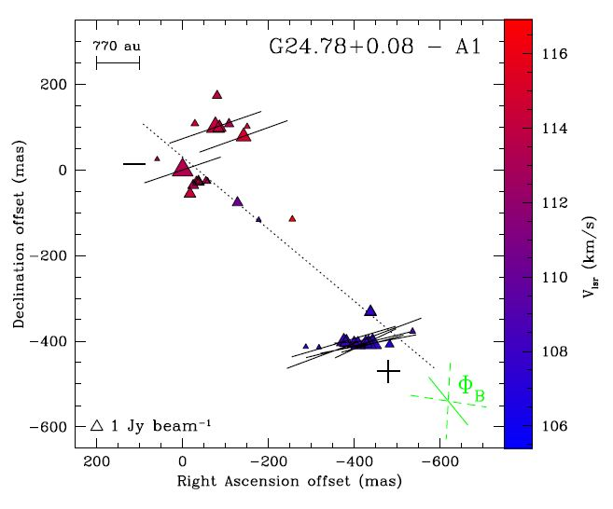
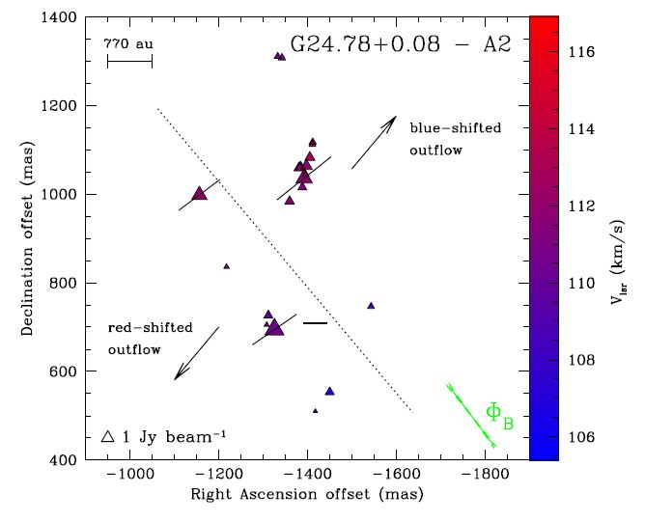
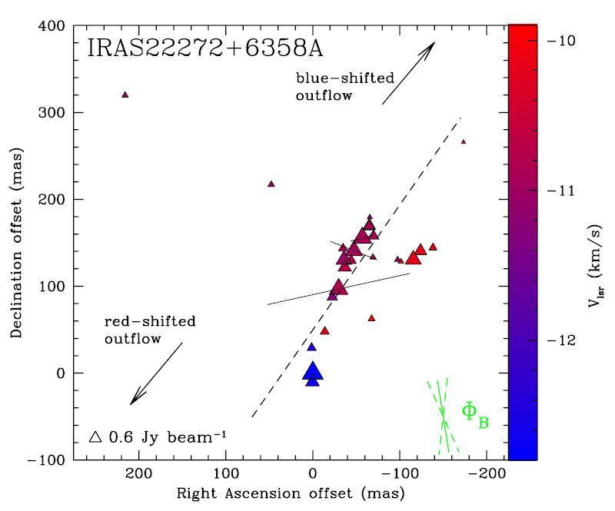
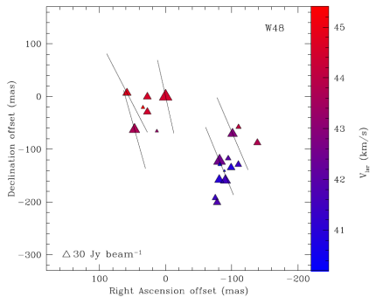
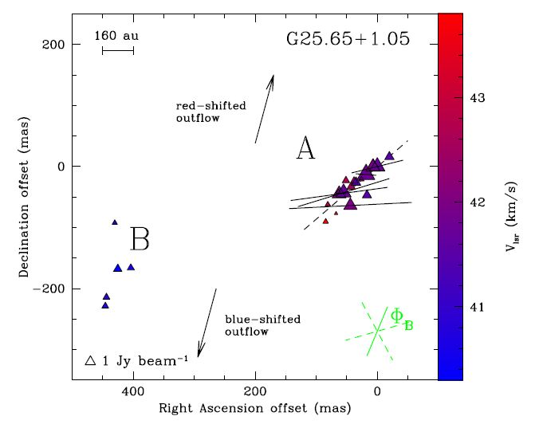
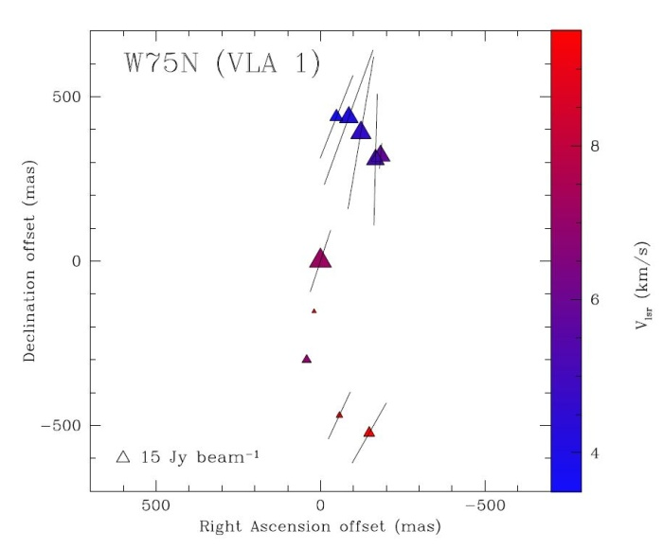
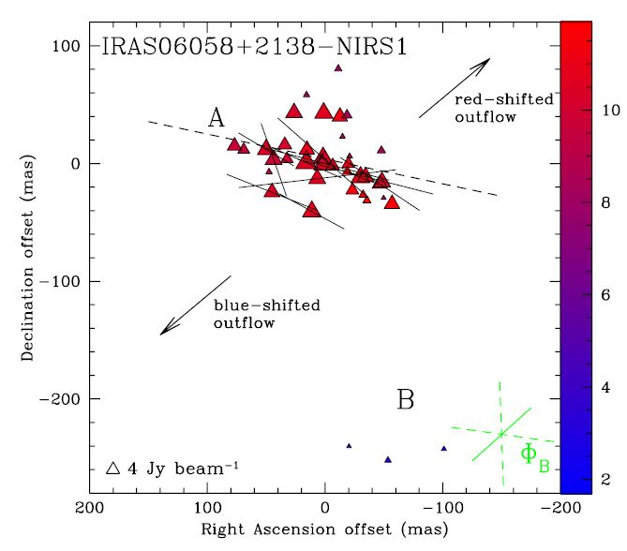
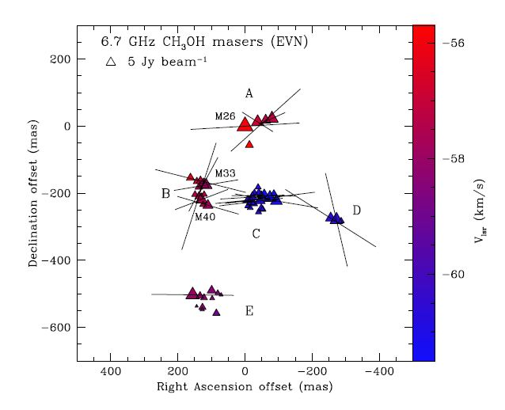
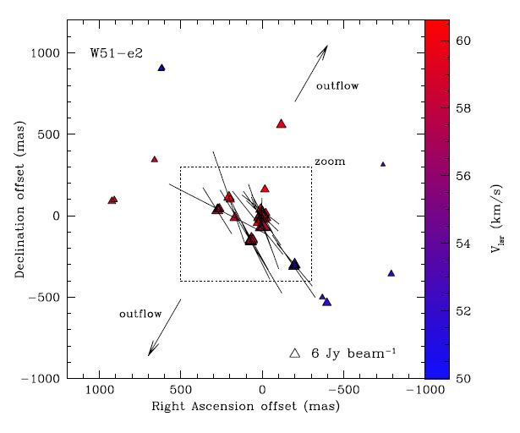
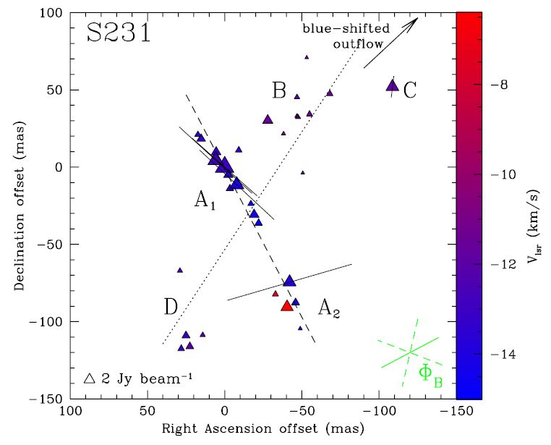
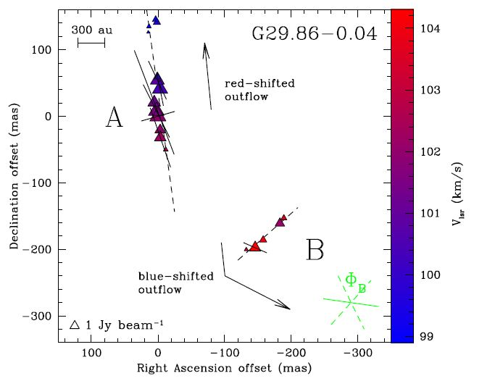
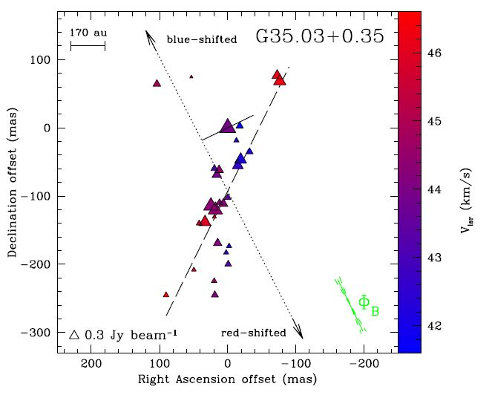
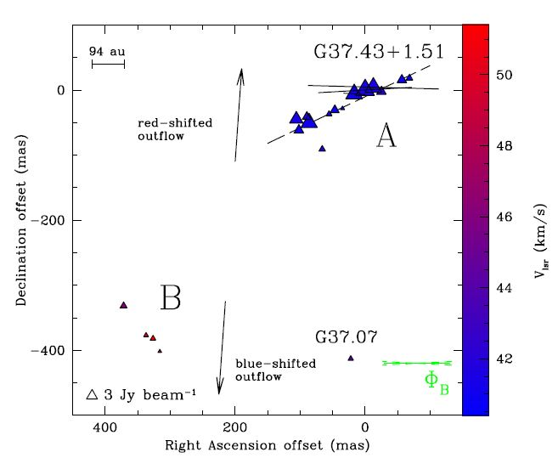
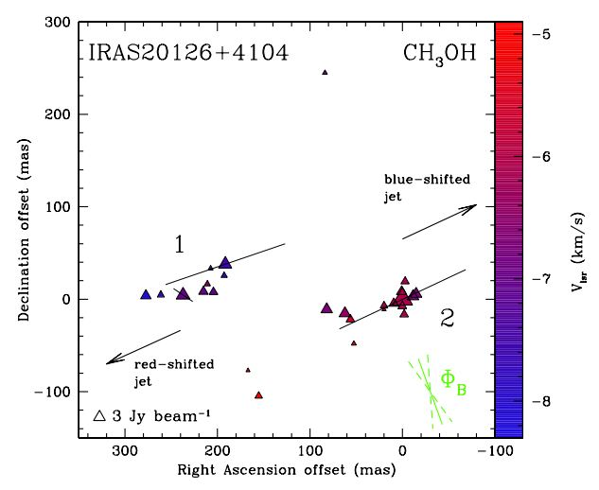
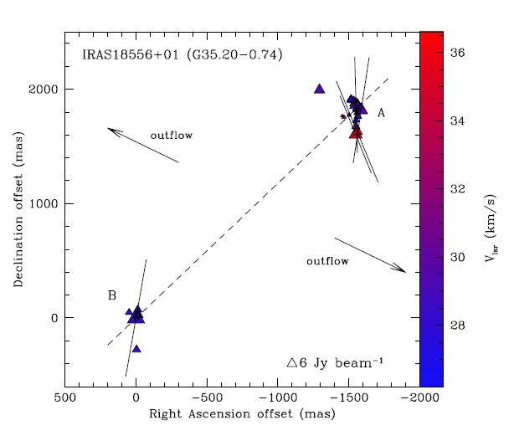
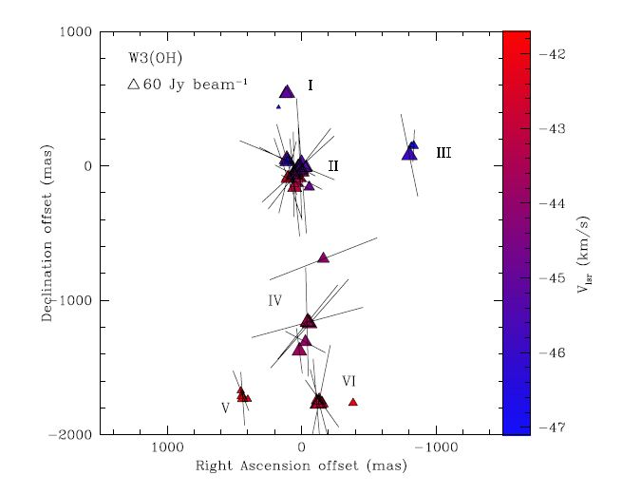
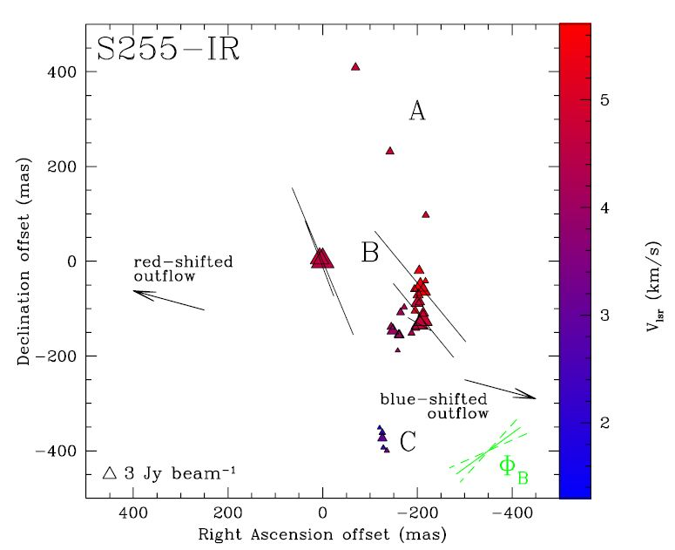
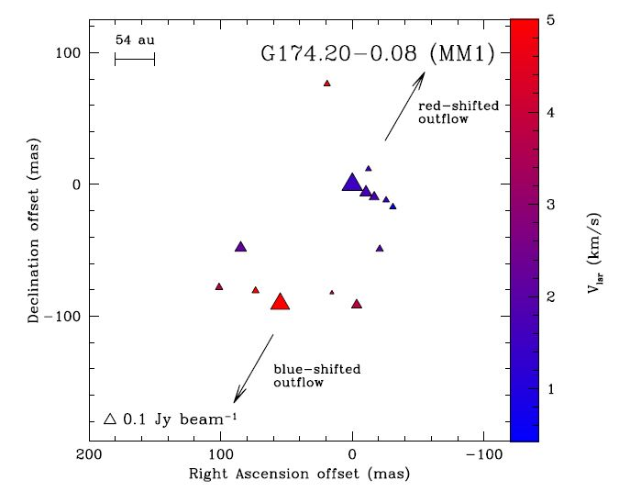
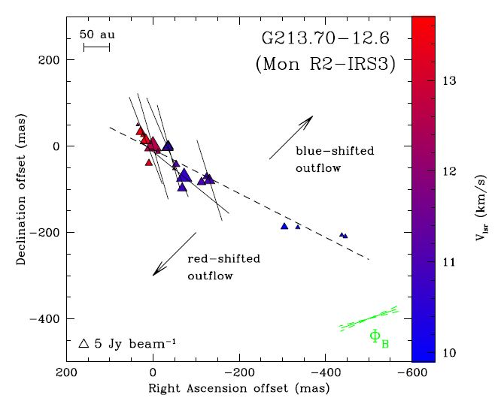
Results
Surcis, G. et al. 2009, 2011, 2012, 2013, 2014, 2015 (in prep.)
12th EVN Symposium – Cagliari 7-10 October 2014 Gabriele Surcis - 9th October 2014

Slide 10
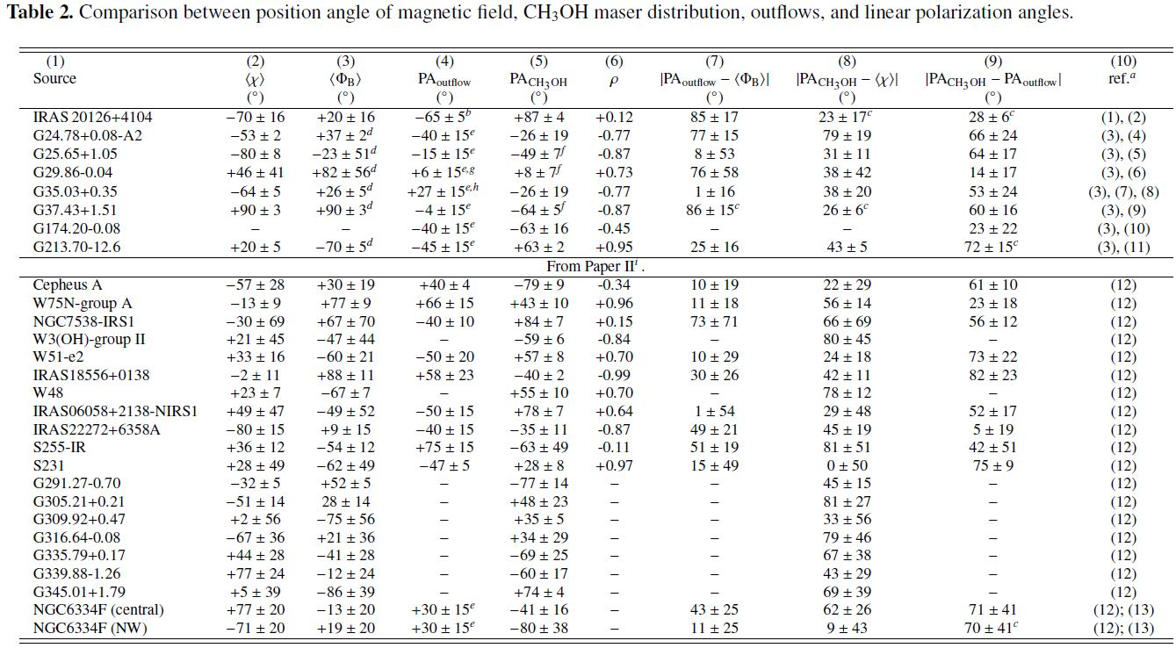
Results: magnetic field total sample (MFTS)
flux limited sample + southern sources (Dodson & Moriarty 2012)
Surcis et al. 2015, A&A, in prep.
Paper II : Surcis et al. 2013, A&A, 556,73
12th EVN Symposium – Cagliari 7-10 October 2014 Gabriele Surcis - 9th October 2014

Slide 11
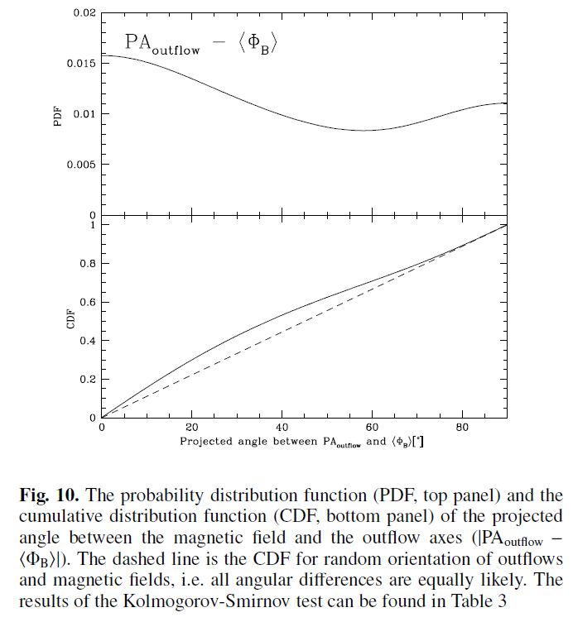
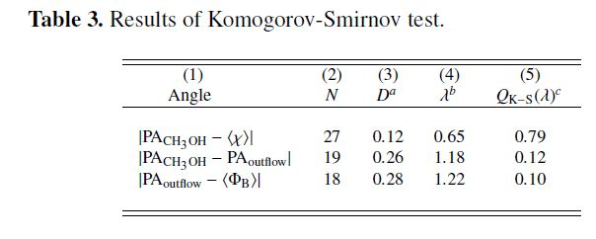
Results: MFTS: first statistical results
Magnetic field oriented along the large scale molecular outflows
Probability that the angles are drawn from random distribution
10%
Surcis et al. 2015, A&A, in prep.
12th EVN Symposium – Cagliari 7-10 October 2014 Gabriele Surcis - 9th October 2014

Slide 12
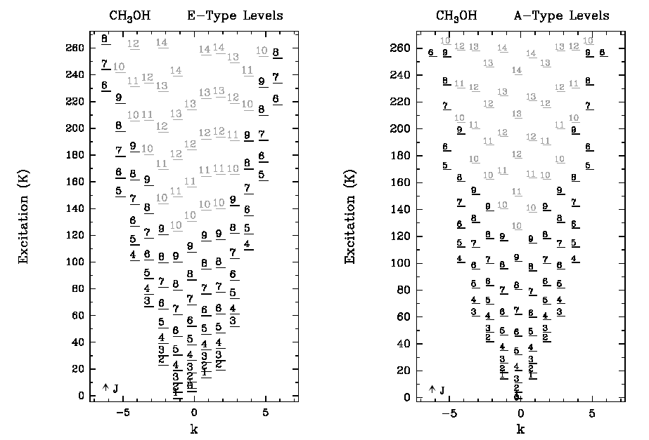
Zeeman-splitting coefficient
CH3OH g-factor is uncertain by at least an order of magnitude
Jen 1951, Phys Rev, 81, 197 «preliminary study» for E-type CH₃OH
Extrapolation indicates that for A⁺ CH₃OH (maser transition) g-factor = 0.141
resulting in α_{6.7GHz} = 0.005 km s⁻¹ G⁻¹
5₁-6₀ A⁺
New measurements are necessary
12th EVN Symposium – Cagliari 7-10 October 2014 Gabriele Surcis - 9th October 2014

Slide 13
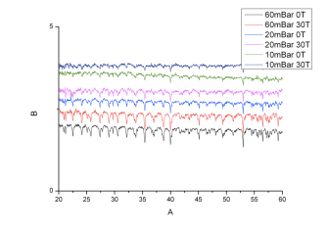
Zeeman-splitting coefficient
FT IR spectrometer
CH3OH supply
vacuum
FIR beam
Magnet facility
(B_{max}=30 Tesla)
30 milions times protostellar B
Dr. Hans Engelkamp (HFML)
He cooled bolometer
12th EVN Symposium – Cagliari 7-10 October 2014 Gabriele Surcis - 9th October 2014

Slide 14
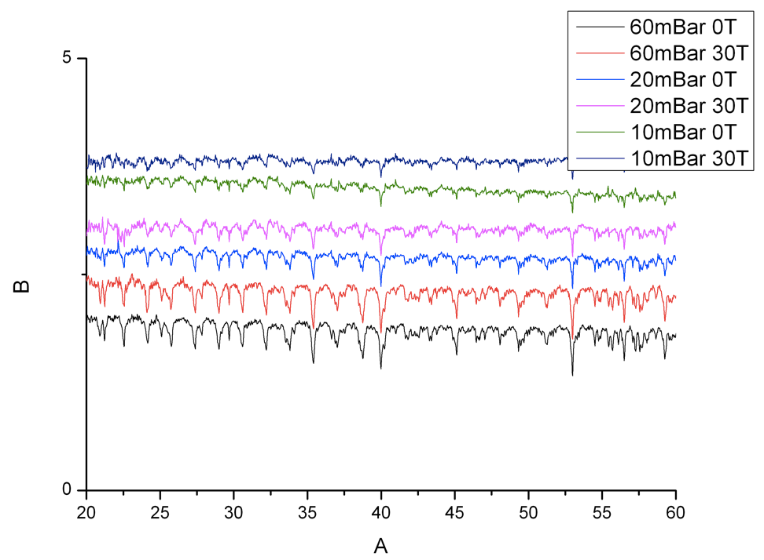
Zeeman-splitting coefficient
November 2013
NO SPLITTING
Intensity
Resolution = 0.03 cm⁻¹ ≈ 0.001 THz
0.6 THz
Wave numbers [cm⁻¹]
1.8 THz
12th EVN Symposium – Cagliari 7-10 October 2014 Gabriele Surcis - 9th October 2014

Slide 15
Zeeman-splitting coefficient
Experimentally
High Field Magnet Laboratory
We are not in the linear regime
Theoretically
Theoretical Chemistry group, Institute for Molecules and Materials
ΔV_{z}
From literature the Zeeman-splitting for B>2.6 Tesla is
not linear, the quadratic term is not negligible.
0
0
2.6 T
First theoretical values of the Landé g-factors for the CH₃OH molecule will be available soon (Lankhaar et al.,
in preparation). (yesterday update: working on the hyperfine effects – coupling rotation and nuclear spin)
12th EVN Symposium – Cagliari 7-10 October 2014 Gabriele Surcis - 9th October 2014

Slide 16
Conclusions
From CH₃OH maser polarized emission we have found that the probability that magnetic fields are aligned with the large-scale outflows in massive YSO is significant
The probability that the CH₃OH maser distributions are perpendicular to the large-scale outflows in massive YSO is also significant
The laboratory measurements of the Landé g-factors for the CH₃OH molecule is extremely challenging
Theoretical calculations are «easier», first values will be available soon.
Follow-ups
To reduce and analyse the remaining sources of the flux-limited sample
(12 massive YSOs)
12th EVN Symposium – Cagliari 7-10 October 2014 Gabriele Surcis - 9th October 2014

Slide 17
GRATZIAS
(Thank you)
12th EVN Symposium – Cagliari 7-10 October 2014 Gabriele Surcis - 9th October 2014

Slide 18
Extra slide
$$\frac{M}{Φ}$$
Mass of the core
Magnetic flux
$$μ=\frac{M/Φ}{\left(M/Φ\right)crit}$$
Column density
$$μ<1$$
Magnetic field
Prevent collapse
$$\frac{M}{Φ}∝\frac{N(H_{2})}{|B|}$$
Magnetic field
Gravity overwhelms
the magnetic field
$$μ>1$$
$${\left(M/Φ\right)}_{crit}≈\frac{0.12}{\sqrt{G}}$$
Gravitational constant
12th EVN Symposium – Cagliari 7-10 October 2014 Gabriele Surcis - 9th October 2014

Slide 19
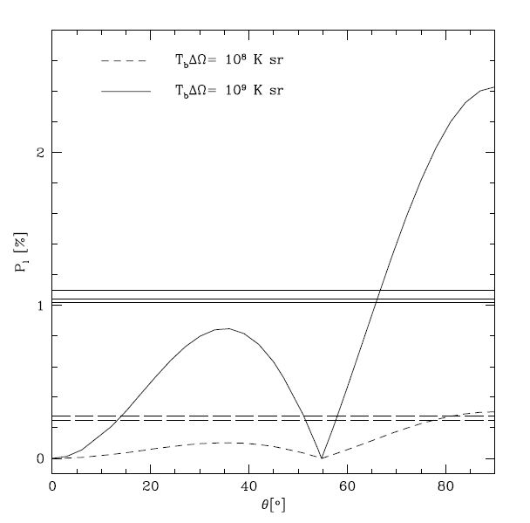
Extra slide
B
θ
φ_{B}
lin. pol.
vector
maser (l.o.s.)
φ_{B} = 0°
φ_{B} = 90°
Goldreich, P et al. 1973, ApJ, 179, 111
12th EVN Symposium – Cagliari 7-10 October 2014 Gabriele Surcis - 9th October 2014

Slide 20
Extra slide
$$∆V_{Z}=\left({10}^{4}g μ_{N}M_{J}\right)∙B_{||}$$
$$α_{Z}$$
$$μ_{N}=\frac{eℏ}{2m_{n}c}$$
= nuclear magneton
$$M_{J}$$
= magnetic quantum number for the rotational transition
12th EVN Symposium – Cagliari 7-10 October 2014 Gabriele Surcis - 9th October 2014

Slide 21
Extra slide
Foreground Faraday Rotation
Ф[°] = 4.22 x 10⁶ D[kpc] n_{e}[cm⁻³] B||[mG] ν⁻²[GHz]
where n_{e}≈ 0.012 cm⁻³ B||≈2x 10⁻³ mG D= 3 kpc
Ф_{meth}[°] ≈ 7.0°
12th EVN Symposium – Cagliari 7-10 October 2014 Gabriele Surcis - 9th October 2014

Slide 22
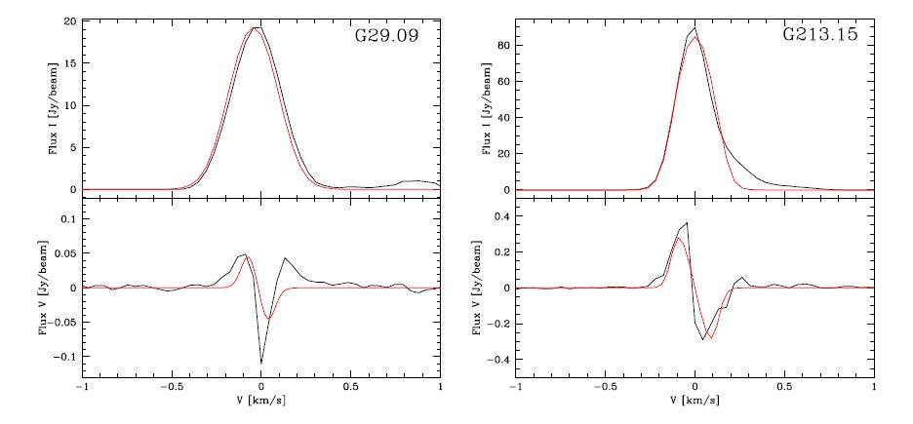
Extra slide
$\text{4} \text{ms}\text{−}\text{1}<|∆V_{Z}$|< 10 ms⁻¹
12th EVN Symposium – Cagliari 7-10 October 2014 Gabriele Surcis - 9th October 2014

Slide 23
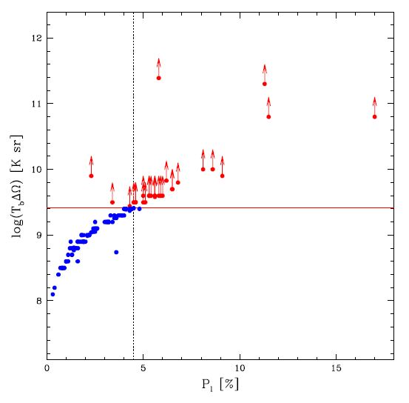
Extra slide
Saturated
unsaturated masers
P_{l} > 4.5%
Unsaturated
12th EVN Symposium – Cagliari 7-10 October 2014 Gabriele Surcis - 9th October 2014

Slide 24
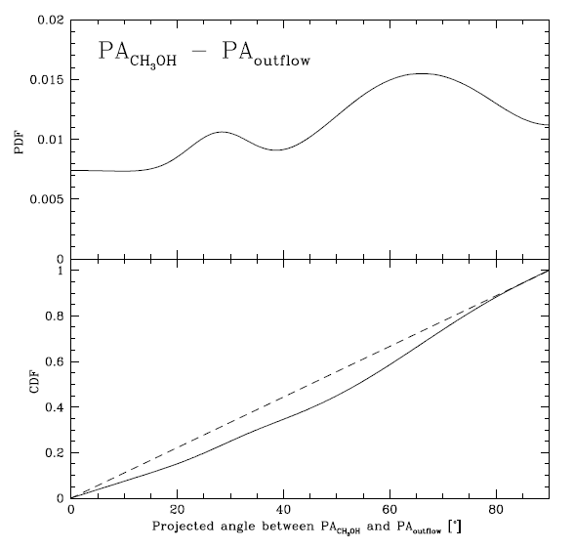
Extra slide
12th EVN Symposium – Cagliari 7-10 October 2014 Gabriele Surcis - 9th October 2014

Slide 25
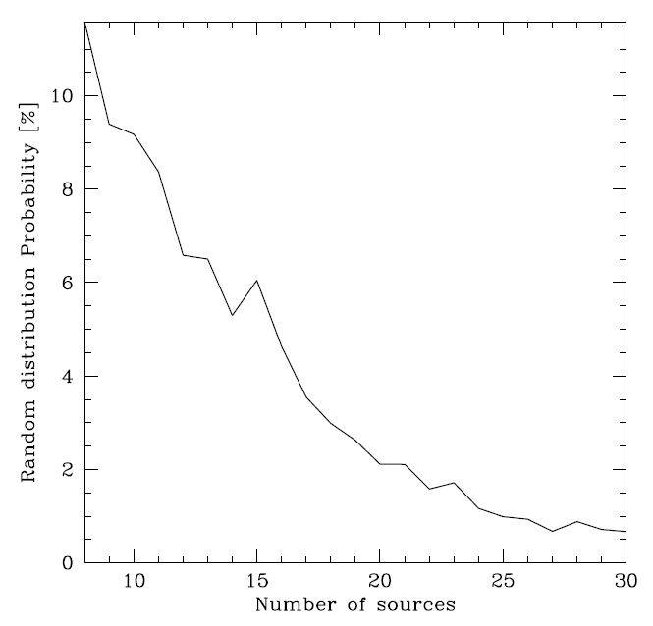
Extra slide
12th EVN Symposium – Cagliari 7-10 October 2014 Gabriele Surcis - 9th October 2014

Slide 26
Extra slide
12th EVN Symposium – Cagliari 7-10 October 2014 Gabriele Surcis - 9th October 2014

